Slide 1
Selection bias in big data:
A practitioner’s point of view
Martin Hyllienmark, Stockholm University, PhD student
Co authors:
Dan Hedlin, Stockholm University, professor
Edgar Bueno, Stockholm University, associate professor
Notes:
Thanks for the introduction
Thank everyone for being here
This work has been done together with Dan Hedlin and Edgar Bueon

Slide 2

Background
Statistic Sweden are currently investigating several new data sources such as online job adds, electricity data, mobile phone data just to mention a few. We shall refer to this kind of data as nonprobability data (NPD).
Often hard to link data sources to our registers due to lack of unique identifiers.
This study aims to compare NPD to a simple random sample with nonresponse (SRS_{m}) when there is a correlation between the study variable and the response indicator. Specifically interested in the effect of different population sizes.
Meng, X. L. (2018). Statistical paradises and paradoxes in big data (i) law of large populations, big data paradox, and the 2016 us presidential election. The Annals of Applied Statistics, 12(2), 685-726.
Simulation study that aim to estimate the population parameter $\overline{Y}$ in a finite population.
For a sequence of growing populations, how do the two different data sources perform in terms of bias, variance, MSE and coverage?
Notes:
nonprobability data can be any kind of data that is not collected with a probability sampling design, e.g. web scraped data
We focus on error caused by missing values,
We assume there answers provided are correct, e.i no measurement error or specification error for example
Realm of design based inference, not model based

Slide 3
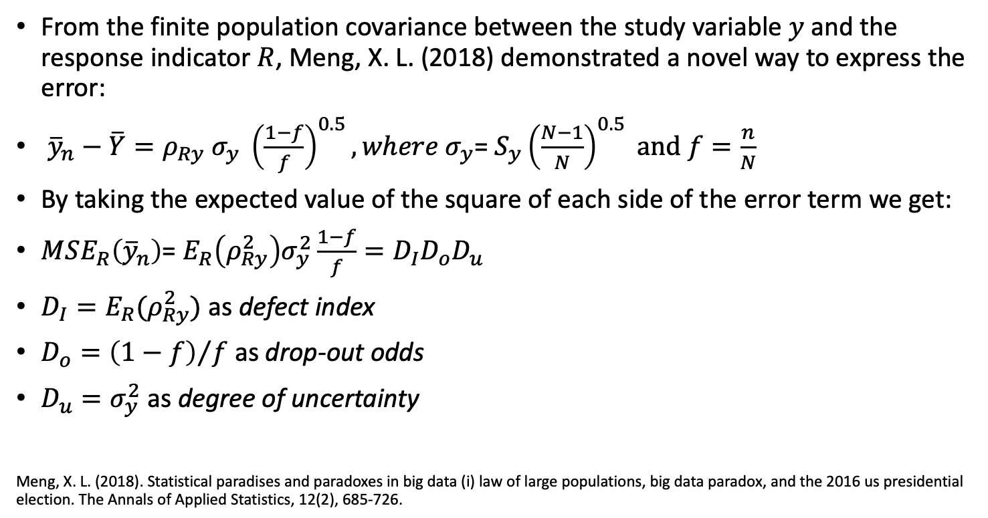
Theory – Error & MSE decomposition
From the finite population covariance between the study variable $y$ and the response indicator $R$, Meng, X. L. (2018) demonstrated a novel way to express the error:
${\overline{y}}_{n}−\overline{Y}=ρ_{Ry} σ_{y} {\left(\frac{1−f}{f}\right)}^{0.5}, where σ_{y}$= ${S_{y}\left(\frac{N−1}{N}\right)}^{0.5} and f=\frac{n}{N}$
By taking the expected value of the square of each side of the error term we get:
$MSE_{R}\left({\overline{y}}_{n}\right)$= $E_{R}\left(ρ_{Ry}^{2}\right)σ_{y}^{2}\frac{1−f}{f}=D_{I}D_{o}D_{u}$
$D_{I}=E_{R}(ρ_{Ry}^{2})$ as defect index
$D_{o}={\left(1−f\right)}/f$ as drop-out odds
$D_{u}=σ_{y}^{2}$ as degree of uncertainty
Meng, X. L. (2018). Statistical paradises and paradoxes in big data (i) law of large populations, big data paradox, and the 2016 us presidential election. The Annals of Applied Statistics, 12(2), 685-726.
Notes:
S finate population variance of y
There are three different components that influence the error
$\text{Data} \text{quality}\text{ ∗ }\text{Problem} \text{difficulty} \text{∗ }\text{Data} \text{quantity}$
Data quality and Data quantity can be modified to reduce the error, e.g. collect more data or focus on hard to reach individuals.
Might be more difficult for nonprobability data
Focus on data quality, not possible to calculate in practise

Slide 4
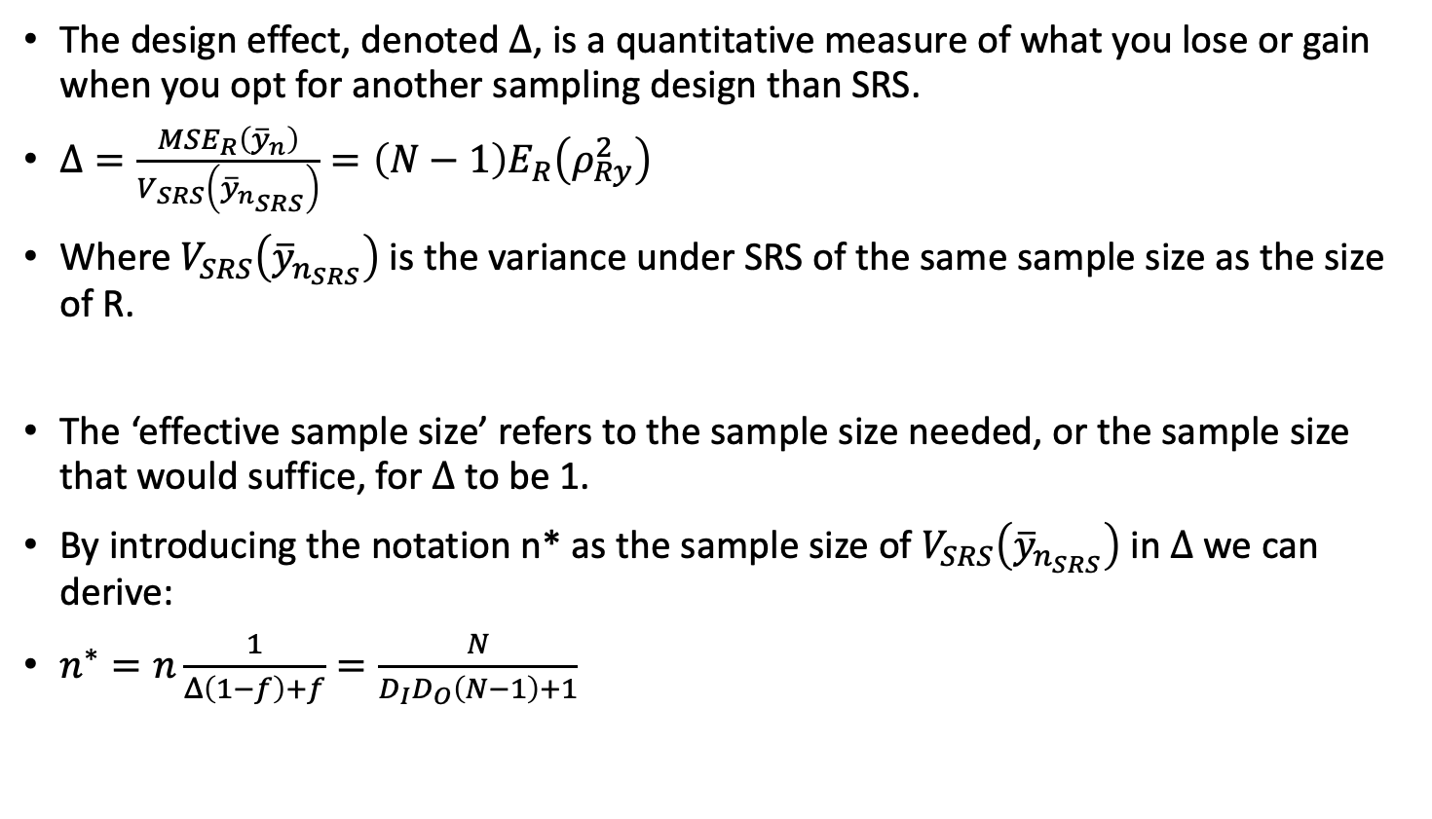
Theory – Design effect and effective sample size
The design effect, denoted $Δ$, is a quantitative measure of what you lose or gain when you opt for another sampling design than SRS.
$Δ=\frac{MSE_{R}\left({\overline{y}}_{n}\right)}{V_{SRS}\left({\overline{y}}_{n_{SRS}}\right)}=\left(N−1\right)E_{R}\left(ρ_{Ry}^{2}\right)$
Where $V_{SRS}\left({\overline{y}}_{n_{SRS}}\right)$ is the variance under SRS of the same sample size as the size of R.
The ‘effective sample size’ refers to the sample size needed, or the sample size that would suffice, for $Δ$ to be 1.
By introducing the notation n* as the sample size of $V_{SRS}\left({\overline{y}}_{n_{SRS}}\right)$ in $Δ$ we can derive:
$n^{∗}=n\frac{1}{Δ\left(1−f\right)+f}=\frac{N}{D_{I}D_{O}\left(N−1\right)+1}$
Notes:
Enables us to compare datasets of the same size

Slide 5
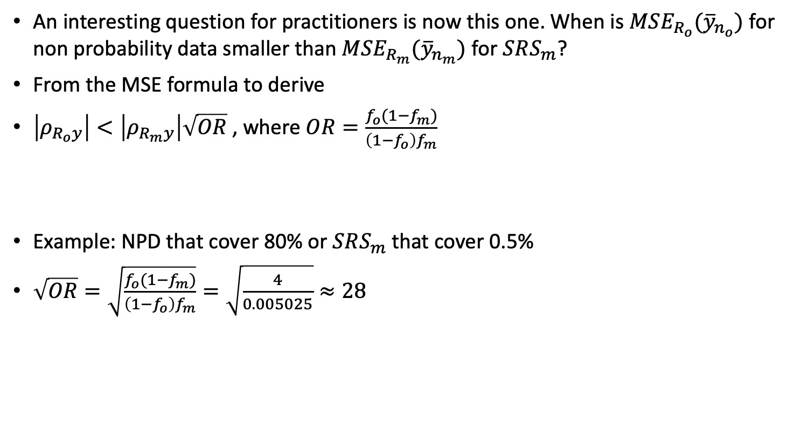
Theory – Comparing data sets
An interesting question for practitioners is now this one. When is $MSE_{R_{o}}({\overline{y}}_{n_{o}})$ for non probability data smaller than ${MSE}_{R_{m}}({\overline{y}}_{n_{m}})$ for $SRS_{m}$?
From the MSE formula to derive
$\left|ρ_{R_{o}y}\right|<\left|ρ_{R_{m}y}\right|\sqrt{OR}$ , where $OR=\frac{f_{o}(1−f_{m})}{\left(1−f_{o}\right)f_{m}}$
Example: NPD that cover 80% or $SRS_{m}$ that cover 0.5%
$\sqrt{OR}=\sqrt{\frac{f_{o}(1−f_{m})}{\left(1−f_{o}\right)f_{m}}}=\sqrt{\frac{4}{0.005025}}≈28$
Notes:
subscript${ R}_{o}$ and $R_{m}$ to indicate there are two difference data sources
Will not know $ρ_{R_{o}y}$ and $ρ_{R_{m}y}.$ Can still be useful to compare datasets, example
Might have enought insight to be able to judge whether probability data have 28 times lower correlation
Cost / benifit

Slide 6
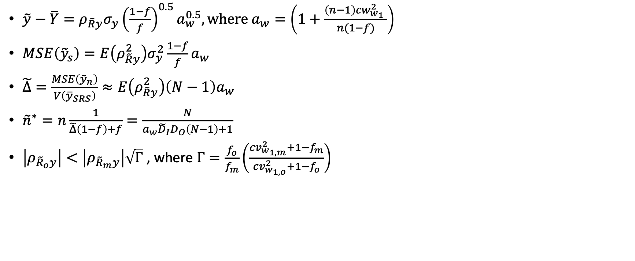
Weighted estimates
$\tilde{y}−\overline{Y}=ρ_{\tilde{R}y}σ_{y}{\left(\frac{1−f}{f}\right)}^{0.5}a_{w}^{0.5}, where{ a}_{w}=\left(1+\frac{\left(n−1\right){cw}_{w_{1}}^{2} }{n(1−f)}\right)$
$MSE\left({\tilde{y}}_{s}\right)=E\left(ρ_{\tilde{R}y}^{2}\right)σ_{y}^{2}\frac{1−f}{f}a_{w}$
$\tilde{Δ}=\frac{MSE\left({\tilde{y}}_{n}\right)}{V\left({\overline{y}}_{SRS}\right)}≈E\left(ρ_{\tilde{R}y}^{2}\right)\left(N−1\right)a_{w}$
${\tilde{n}}^{∗}=n\frac{1}{\tilde{Δ}\left(1−f\right)+f}=\frac{N}{{a_{w}\tilde{D}}_{I}D_{O}\left(N−1\right)+1}$
$\left|ρ_{{\tilde{R}}_{o}y}\right|<\left|ρ_{{\tilde{R}}_{m}y}\right|\sqrt{Γ}$ , where $Γ=\frac{f_{o}}{f_{m}}\left(\frac{cv_{w_{1,m}}^{2}+1−f_{m}}{cv_{w_{1,o}}^{2}+1−f_{o}}\right)$
Notes:
We do the same for weighted estimates, will not go over the details here
In this paper, we use poststratification

Slide 7
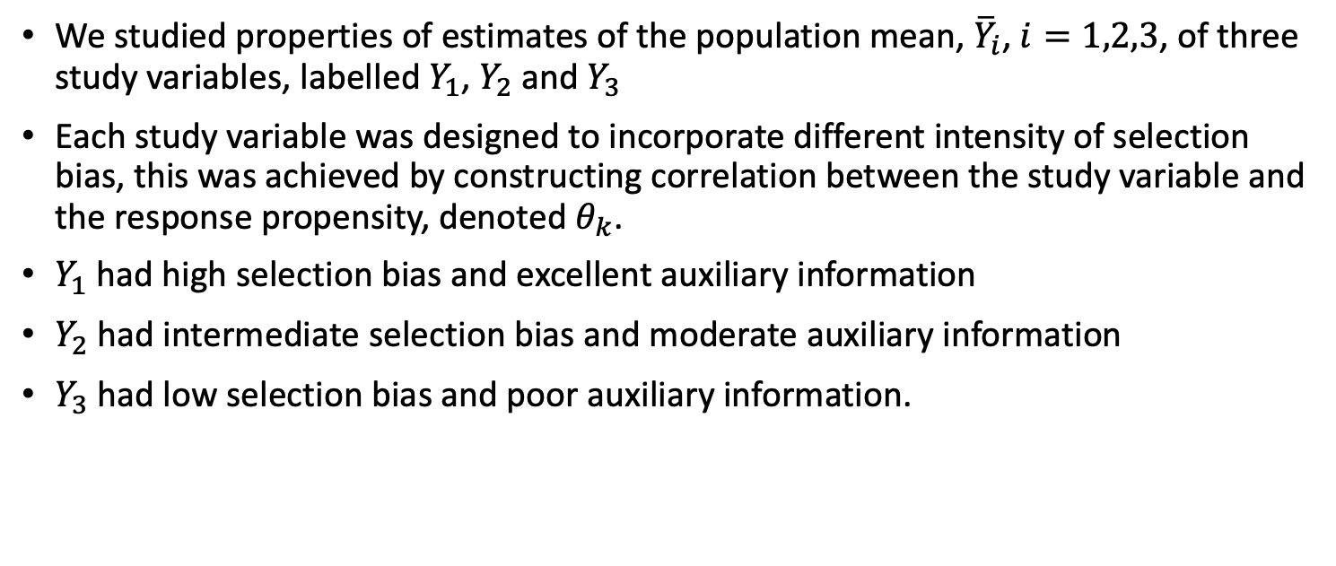
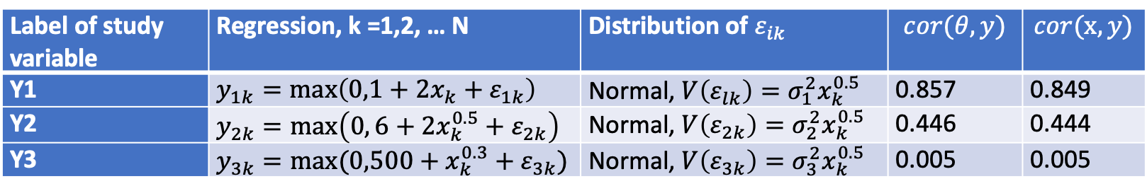
Simulation – Populations
We studied properties of estimates of the population mean, ${\overline{Y}}_{i}$, $i=1,2,3$, of three study variables, labelled $Y_{1}$, $Y_{2}$ and $Y_{3}$
Each study variable was designed to incorporate different intensity of selection bias, this was achieved by constructing correlation between the study variable and the response propensity, denoted $θ_{k}$.
$Y_{1}$ had high selection bias and excellent auxiliary information
$Y_{2}$ had intermediate selection bias and moderate auxiliary information
$Y_{3}$ had low selection bias and poor auxiliary information.
Label of study variable | Regression, k =1,2, … N | Distribution of $ε_{ik}$ | $$cor(θ,y)$$ | $$cor(x,y)$$
Y1 | $y_{1k}=\max\left(0,1+2x_{k}+ε_{1k}\right)$ | Normal, $V\left(ε_{lk}\right)=σ_{1}^{2}x_{k}^{0.5}$ | 0.857 | 0.849
Y2 | $y_{2k}=\max\left(0, 6+2x_{k}^{0.5}+ε_{2k}\right)$ | Normal, $V\left(ε_{2k}\right)=σ_{2}^{2}x_{k}^{0.5}$ | 0.446 | 0.444
Y3 | $y_{3k}=max⁡(0,500+x_{k}^{0.3}+ε_{3k})$ | Normal, $V\left(ε_{3k}\right)=σ_{3}^{2}x_{k}^{0.5}$ | 0.005 | 0.005
Table 1. The generation of study variables $Y_{1}$, $Y_{2}$ and $Y_{3}.$ $x_{k}\sim gamma\left(1,1\right), k=1,…,N.$ Also generate $t_{k}= 50+{4x}_{k}+ε_{4k}$ for poststratification. $ε_{lk}=0$ for $l=1,2,3,4$. All $ε_{lk}$ were drawn independently.
Notes:
Theta is the response propensity
X is an auxiliary variable used for post stratification

Slide 8
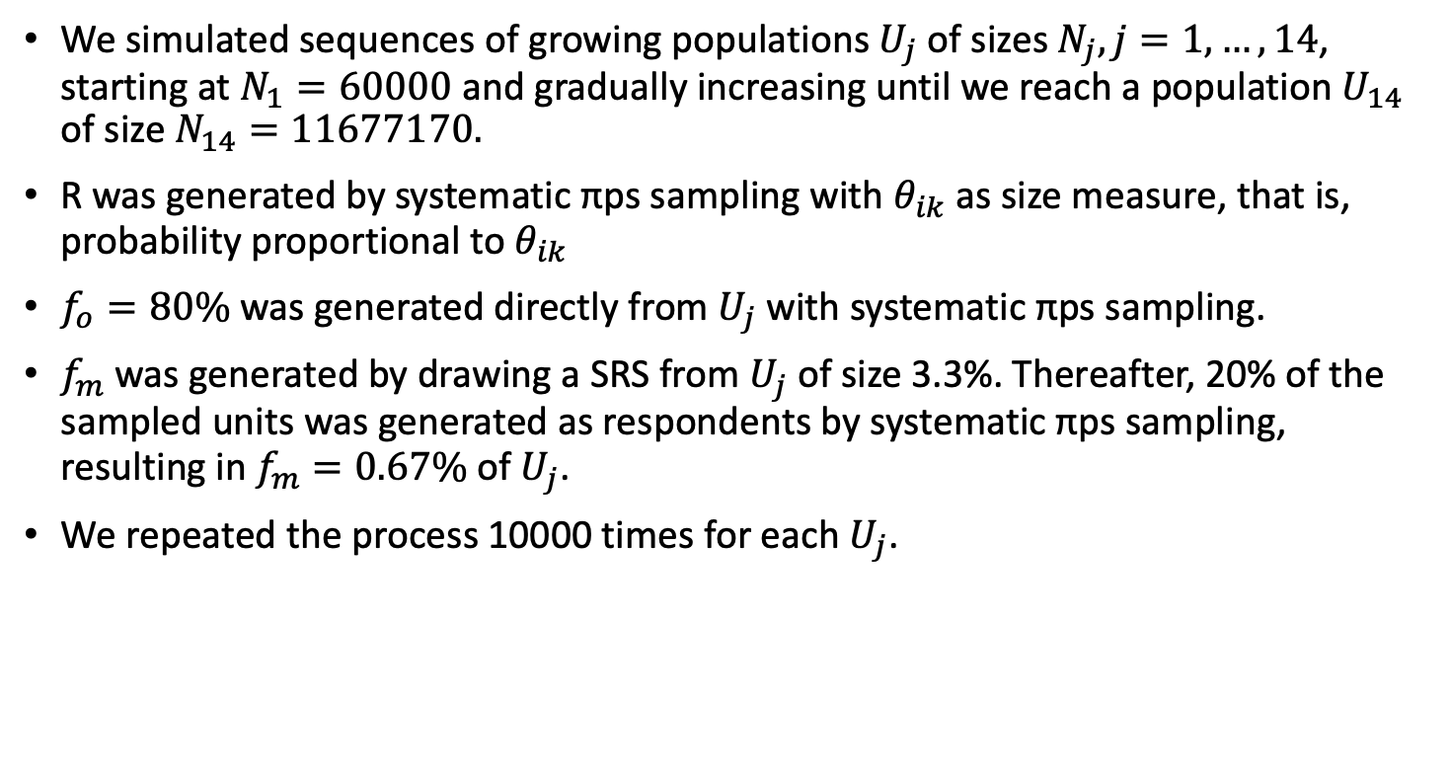
Simulation - Populations size
We simulated sequences of growing populations $U_{j}$ of sizes $N_{j}, j=1,…,14$, starting at $N_{1}=60000$ and gradually increasing until we reach a population $U_{14}$ of size $N_{14}=11677170.$
R was generated by systematic πps sampling with $θ_{ik}$ as size measure, that is, probability proportional to $θ_{ik}$
$f_{o}=80\%$was generated directly from $U_{j}$ with systematic πps sampling.
$f_{m}$ was generated by drawing a SRS from $U_{j}$ of size 3.3%. Thereafter, 20% of the sampled units was generated as respondents by systematic πps sampling, resulting in $f_{m}=0.67\%$of $U_{j}$.
We repeated the process 10000 times for each $U_{j}$.

Slide 9
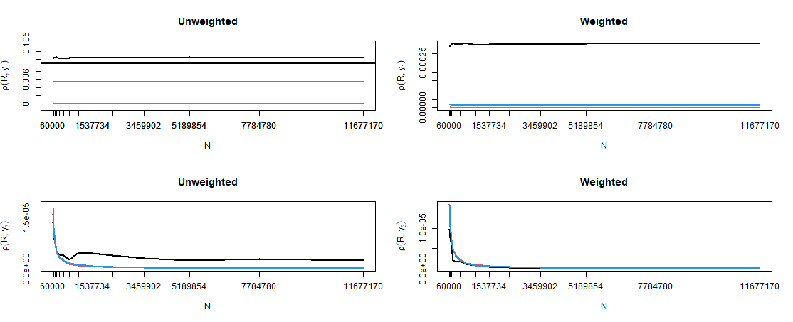

${\text{D}\text{efect} \text{index} D}_{I}=E_{R}\left(ρ_{Ry}^{2}\right)$
Simple random sample (full response)
Simple random sample with nonresponse
Nonprobability data
Notes:
Correlation between study variable and response indicator
Generally higher for NPD compare to SRSm
Y1: NPD had substantially higher correlation compared to SRS_{m}
Y3: Similar correlation
For a SRS with full response, the correlation would be equal to 1/N

Slide 10
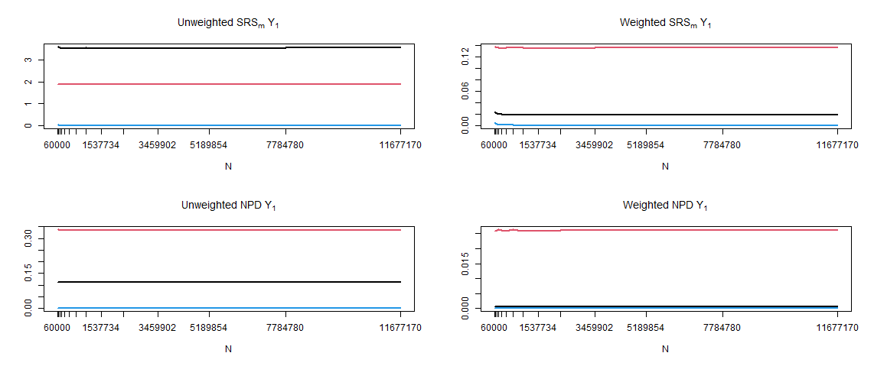
Evaluation of Bias, Variance & MSE
Bias
Variance
Mean square error
Notes:
Lower bias and variance in NPD compared to SRSm
Remain fixed as N grow

Slide 11
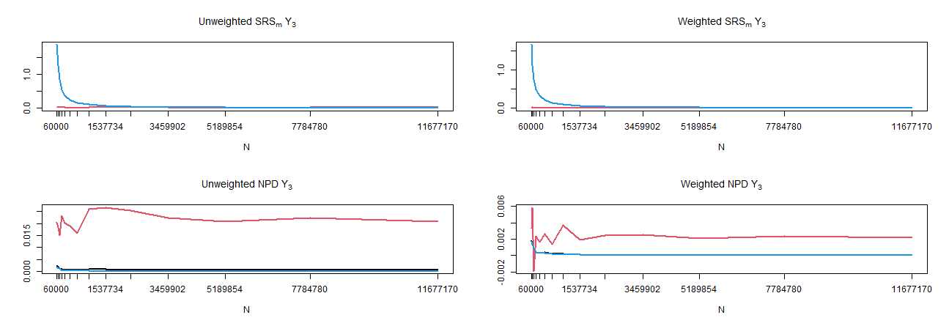
Evaluation of Bias, Variance & MSE
Bias
Variance
Mean square error
Notes:
Decrease for SRSm an

Slide 12
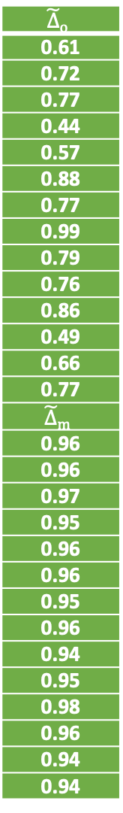
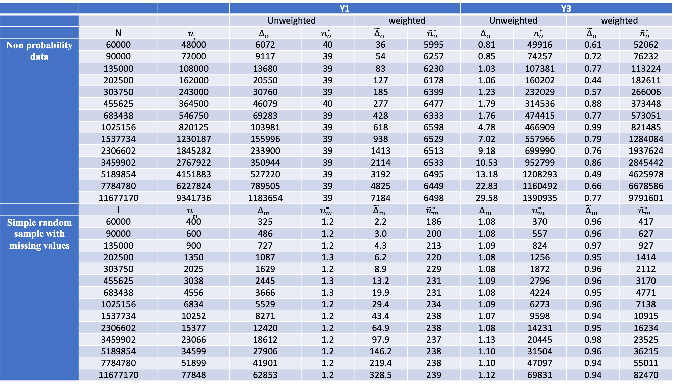
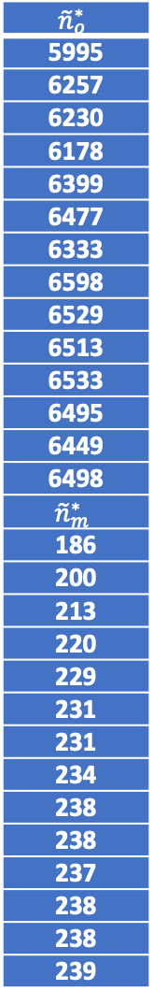
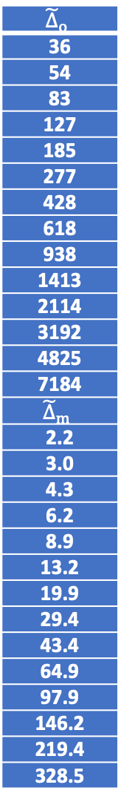
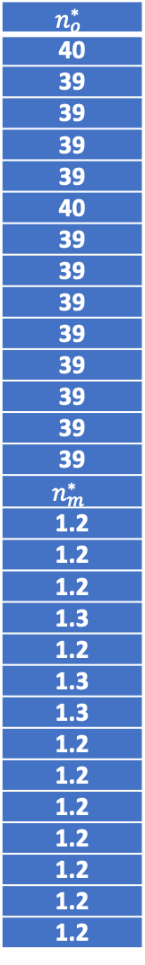
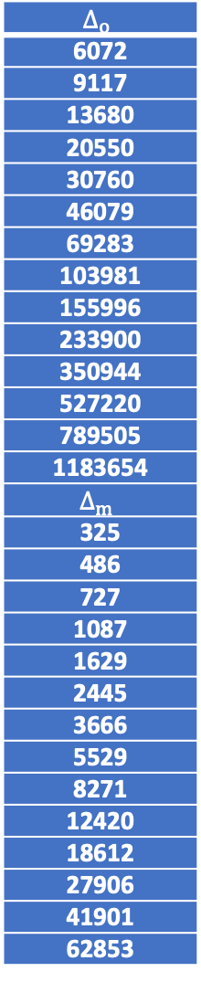
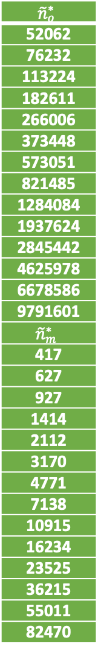
 |  |  | Y1 |  |  |  | Y3
 |  |  | Unweighted |  | weighted |  | Unweighted |  | weighted
 | N | $$n_{o}$$ | $$Δ_{o}$$ | $$n_{o}^{∗}$$ | $${\tilde{Δ}}_{o}$$ | $${\tilde{n}}_{o}^{∗}$$ | $$Δ_{o}$$ | $$n_{o}^{∗}$$ | $${\tilde{Δ}}_{o}$$ | $${\tilde{n}}_{o}^{∗}$$
Non probability data | 60000 | 48000 | 6072 | 40 | 36 | 5995 | 0.81 | 49916 | 0.61 | 52062
 | 90000 | 72000 | 9117 | 39 | 54 | 6257 | 0.85 | 74257 | 0.72 | 76232
 | 135000 | 108000 | 13680 | 39 | 83 | 6230 | 1.03 | 107381 | 0.77 | 113224
 | 202500 | 162000 | 20550 | 39 | 127 | 6178 | 1.06 | 160202 | 0.44 | 182611
 | 303750 | 243000 | 30760 | 39 | 185 | 6399 | 1.23 | 232029 | 0.57 | 266006
 | 455625 | 364500 | 46079 | 40 | 277 | 6477 | 1.79 | 314536 | 0.88 | 373448
 | 683438 | 546750 | 69283 | 39 | 428 | 6333 | 1.76 | 474415 | 0.77 | 573051
 | 1025156 | 820125 | 103981 | 39 | 618 | 6598 | 4.78 | 466909 | 0.99 | 821485
 | 1537734 | 1230187 | 155996 | 39 | 938 | 6529 | 7.02 | 557966 | 0.79 | 1284084
 | 2306602 | 1845282 | 233900 | 39 | 1413 | 6513 | 9.18 | 699990 | 0.76 | 1937624
 | 3459902 | 2767922 | 350944 | 39 | 2114 | 6533 | 10.53 | 952799 | 0.86 | 2845442
 | 5189854 | 4151883 | 527220 | 39 | 3192 | 6495 | 13.18 | 1208293 | 0.49 | 4625978
 | 7784780 | 6227824 | 789505 | 39 | 4825 | 6449 | 22.83 | 1160492 | 0.66 | 6678586
 | 11677170 | 9341736 | 1183654 | 39 | 7184 | 6498 | 29.58 | 1390935 | 0.77 | 9791601
 | I | $$n_{m}$$ | $$Δ_{m}$$ | $$n_{m}^{∗}$$ | $${\tilde{Δ}}_{m}$$ | $${\tilde{n}}_{m}^{∗}$$ | $$Δ_{m}$$ | $$n_{m}^{∗}$$ | $${\tilde{Δ}}_{m}$$ | $${\tilde{n}}_{m}^{∗}$$
Simple random sample with missing values | 60000 | 400 | 325 | 1.2 | 2.2 | 186 | 1.08 | 370 | 0.96 | 417
 | 90000 | 600 | 486 | 1.2 | 3.0 | 200 | 1.08 | 557 | 0.96 | 627
 | 135000 | 900 | 727 | 1.2 | 4.3 | 213 | 1.09 | 824 | 0.97 | 927
 | 202500 | 1350 | 1087 | 1.3 | 6.2 | 220 | 1.08 | 1256 | 0.95 | 1414
 | 303750 | 2025 | 1629 | 1.2 | 8.9 | 229 | 1.08 | 1872 | 0.96 | 2112
 | 455625 | 3038 | 2445 | 1.3 | 13.2 | 231 | 1.09 | 2796 | 0.96 | 3170
 | 683438 | 4556 | 3666 | 1.3 | 19.9 | 231 | 1.08 | 4224 | 0.95 | 4771
 | 1025156 | 6834 | 5529 | 1.2 | 29.4 | 234 | 1.09 | 6273 | 0.96 | 7138
 | 1537734 | 10252 | 8271 | 1.2 | 43.4 | 238 | 1.07 | 9598 | 0.94 | 10915
 | 2306602 | 15377 | 12420 | 1.2 | 64.9 | 238 | 1.08 | 14231 | 0.95 | 16234
 | 3459902 | 23066 | 18612 | 1.2 | 97.9 | 237 | 1.13 | 20445 | 0.98 | 23525
 | 5189854 | 34599 | 27906 | 1.2 | 146.2 | 238 | 1.10 | 31504 | 0.96 | 36215
 | 7784780 | 51899 | 41901 | 1.2 | 219.4 | 238 | 1.10 | 47097 | 0.94 | 55011
 | 11677170 | 77848 | 62853 | 1.2 | 328.5 | 239 | 1.12 | 69831 | 0.94 | 82470
$$Δ_{o}$$
6072
9117
13680
20550
30760
46079
69283
103981
155996
233900
350944
527220
789505
1183654
$$Δ_{m}$$
325
486
727
1087
1629
2445
3666
5529
8271
12420
18612
27906
41901
62853
$$n_{o}^{∗}$$
40
39
39
39
39
40
39
39
39
39
39
39
39
39
$$n_{m}^{∗}$$
1.2
1.2
1.2
1.3
1.2
1.3
1.3
1.2
1.2
1.2
1.2
1.2
1.2
1.2
$${\tilde{Δ}}_{o}$$
36
54
83
127
185
277
428
618
938
1413
2114
3192
4825
7184
$${\tilde{Δ}}_{m}$$
2.2
3.0
4.3
6.2
8.9
13.2
19.9
29.4
43.4
64.9
97.9
146.2
219.4
328.5
$${\tilde{n}}_{o}^{∗}$$
5995
6257
6230
6178
6399
6477
6333
6598
6529
6513
6533
6495
6449
6498
$${\tilde{n}}_{m}^{∗}$$
186
200
213
220
229
231
231
234
238
238
237
238
238
239
$${\tilde{Δ}}_{o}$$
0.61
0.72
0.77
0.44
0.57
0.88
0.77
0.99
0.79
0.76
0.86
0.49
0.66
0.77
$${\tilde{Δ}}_{m}$$
0.96
0.96
0.97
0.95
0.96
0.96
0.95
0.96
0.94
0.95
0.98
0.96
0.94
0.94
$${\tilde{n}}_{o}^{∗}$$
52062
76232
113224
182611
266006
373448
573051
821485
1284084
1937624
2845442
4625978
6678586
9791601
$${\tilde{n}}_{m}^{∗}$$
417
627
927
1414
2112
3170
4771
7138
10915
16234
23525
36215
55011
82470
Notes:
NPD:
$n_{o}^{∗}$ and MSE remain constant as N increase while $Δ_{o}$ increases
That is, to retain constant MSE we must maintain the sampling fraction of 80%.
If we were fortunate enough to have an SRS with full response, only 39 respondents would be needed, no matter the population size.
Improved substantially by weighted, however, still an increased design effect as N grow
SRSm:
was comparatively lower design effect than for NPD
even for $SRS_{m}$, the damaging effect of the population size is present
${\tilde{Δ}}_{m}$ still increases with N while MSE remains rather constant.
A slight increase in ${\tilde{n}}_{m}^{∗}$ was observed, just as when weights were applied in organic data. This suggests that the weights to a minor degree counter the negative effect of increased population size.

Slide 13
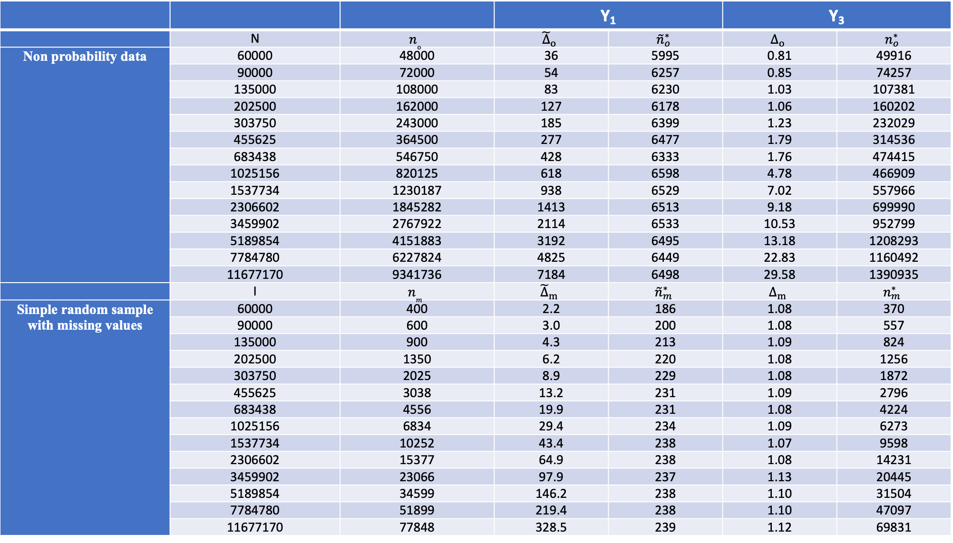
 |  |  | Y₁ |  | Y₃
 | N | $$n_{o}$$ | $${\tilde{Δ}}_{o}$$ | $${\tilde{n}}_{o}^{∗}$$ | $$Δ_{o}$$ | $$n_{o}^{∗}$$
Non probability data | 60000 | 48000 | 36 | 5995 | 0.81 | 49916
 | 90000 | 72000 | 54 | 6257 | 0.85 | 74257
 | 135000 | 108000 | 83 | 6230 | 1.03 | 107381
 | 202500 | 162000 | 127 | 6178 | 1.06 | 160202
 | 303750 | 243000 | 185 | 6399 | 1.23 | 232029
 | 455625 | 364500 | 277 | 6477 | 1.79 | 314536
 | 683438 | 546750 | 428 | 6333 | 1.76 | 474415
 | 1025156 | 820125 | 618 | 6598 | 4.78 | 466909
 | 1537734 | 1230187 | 938 | 6529 | 7.02 | 557966
 | 2306602 | 1845282 | 1413 | 6513 | 9.18 | 699990
 | 3459902 | 2767922 | 2114 | 6533 | 10.53 | 952799
 | 5189854 | 4151883 | 3192 | 6495 | 13.18 | 1208293
 | 7784780 | 6227824 | 4825 | 6449 | 22.83 | 1160492
 | 11677170 | 9341736 | 7184 | 6498 | 29.58 | 1390935
 | I | $$n_{m}$$ | $${\tilde{Δ}}_{m}$$ | $${\tilde{n}}_{m}^{∗}$$ | $$Δ_{m}$$ | $$n_{m}^{∗}$$
Simple random sample with missing values | 60000 | 400 | 2.2 | 186 | 1.08 | 370
 | 90000 | 600 | 3.0 | 200 | 1.08 | 557
 | 135000 | 900 | 4.3 | 213 | 1.09 | 824
 | 202500 | 1350 | 6.2 | 220 | 1.08 | 1256
 | 303750 | 2025 | 8.9 | 229 | 1.08 | 1872
 | 455625 | 3038 | 13.2 | 231 | 1.09 | 2796
 | 683438 | 4556 | 19.9 | 231 | 1.08 | 4224
 | 1025156 | 6834 | 29.4 | 234 | 1.09 | 6273
 | 1537734 | 10252 | 43.4 | 238 | 1.07 | 9598
 | 2306602 | 15377 | 64.9 | 238 | 1.08 | 14231
 | 3459902 | 23066 | 97.9 | 237 | 1.13 | 20445
 | 5189854 | 34599 | 146.2 | 238 | 1.10 | 31504
 | 7784780 | 51899 | 219.4 | 238 | 1.10 | 47097
 | 11677170 | 77848 | 328.5 | 239 | 1.12 | 69831
Notes:
Highlight two parts that was interesting, namely weighted Y1 and unweighted Y3
NPD:
$n_{o}^{∗}$ remain rather constant as N increase while $Δ_{o}$ increases
That is, to retain constant MSE we must maintain the sampling fraction of 80%.
SRSm:
was comparatively lower design effect than for NPD
even for $SRS_{m}$, the damaging effect of the population size is present
A slight increase in ${\tilde{n}}_{m}^{∗}$ was observed, just as when weights were applied in organic data. This suggests that the weights to a minor degree counter the negative effect of increased population size.

Slide 14
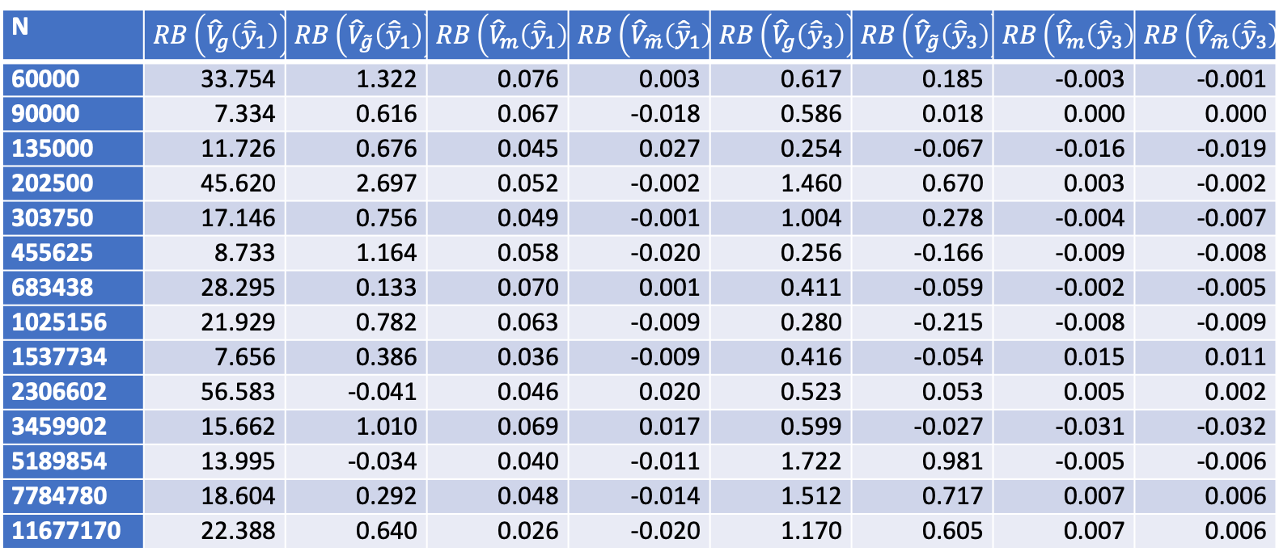
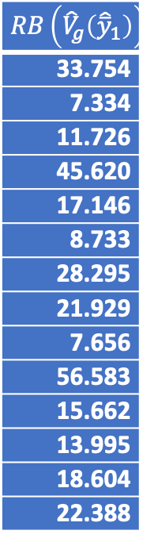
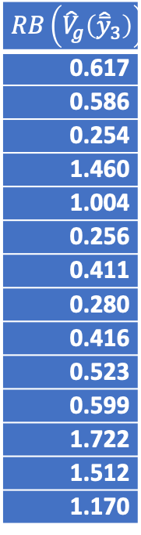
Relative bias of the variance estimate
N | $RB\left({\hat{V}}_{g}\left({\hat{\overline{y}}}_{1}\right)\right)$ | $RB\left({\hat{V}}_{\tilde{g}}\left({\hat{\overline{y}}}_{1}\right)\right)$ | $RB\left({\hat{V}}_{m}\left({\hat{\overline{y}}}_{1}\right)\right)$ | $RB\left({\hat{V}}_{\tilde{m}}\left({\hat{\overline{y}}}_{1}\right)\right)$ | $RB\left({\hat{V}}_{g}\left({\hat{\overline{y}}}_{3}\right)\right)$ | $RB\left({\hat{V}}_{\tilde{g}}\left({\hat{\overline{y}}}_{3}\right)\right)$ | $RB\left({\hat{V}}_{m}\left({\hat{\overline{y}}}_{3}\right)\right)$ | $RB\left({\hat{V}}_{\tilde{m}}\left({\hat{\overline{y}}}_{3}\right)\right)$
60000 | 33.754 | 1.322 | 0.076 | 0.003 | 0.617 | 0.185 | -0.003 | -0.001
90000 | 7.334 | 0.616 | 0.067 | -0.018 | 0.586 | 0.018 | 0.000 | 0.000
135000 | 11.726 | 0.676 | 0.045 | 0.027 | 0.254 | -0.067 | -0.016 | -0.019
202500 | 45.620 | 2.697 | 0.052 | -0.002 | 1.460 | 0.670 | 0.003 | -0.002
303750 | 17.146 | 0.756 | 0.049 | -0.001 | 1.004 | 0.278 | -0.004 | -0.007
455625 | 8.733 | 1.164 | 0.058 | -0.020 | 0.256 | -0.166 | -0.009 | -0.008
683438 | 28.295 | 0.133 | 0.070 | 0.001 | 0.411 | -0.059 | -0.002 | -0.005
1025156 | 21.929 | 0.782 | 0.063 | -0.009 | 0.280 | -0.215 | -0.008 | -0.009
1537734 | 7.656 | 0.386 | 0.036 | -0.009 | 0.416 | -0.054 | 0.015 | 0.011
2306602 | 56.583 | -0.041 | 0.046 | 0.020 | 0.523 | 0.053 | 0.005 | 0.002
3459902 | 15.662 | 1.010 | 0.069 | 0.017 | 0.599 | -0.027 | -0.031 | -0.032
5189854 | 13.995 | -0.034 | 0.040 | -0.011 | 1.722 | 0.981 | -0.005 | -0.006
7784780 | 18.604 | 0.292 | 0.048 | -0.014 | 1.512 | 0.717 | 0.007 | 0.006
11677170 | 22.388 | 0.640 | 0.026 | -0.020 | 1.170 | 0.605 | 0.007 | 0.006
$RB\left({\hat{V}}_{g}\left({\hat{\overline{y}}}_{1}\right)\right)$
33.754
7.334
11.726
45.620
17.146
8.733
28.295
21.929
7.656
56.583
15.662
13.995
18.604
22.388
$RB\left({\hat{V}}_{g}\left({\hat{\overline{y}}}_{3}\right)\right)$
0.617
0.586
0.254
1.460
1.004
0.256
0.411
0.280
0.416
0.523
0.599
1.722
1.512
1.170
Table 12. Each column shows the variance of the relative bias of the variance. Positive values of the relative bias indicate an overestimated variance.
Notes:
NPD over esimate the variance

Slide 15
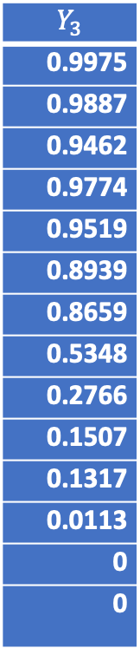
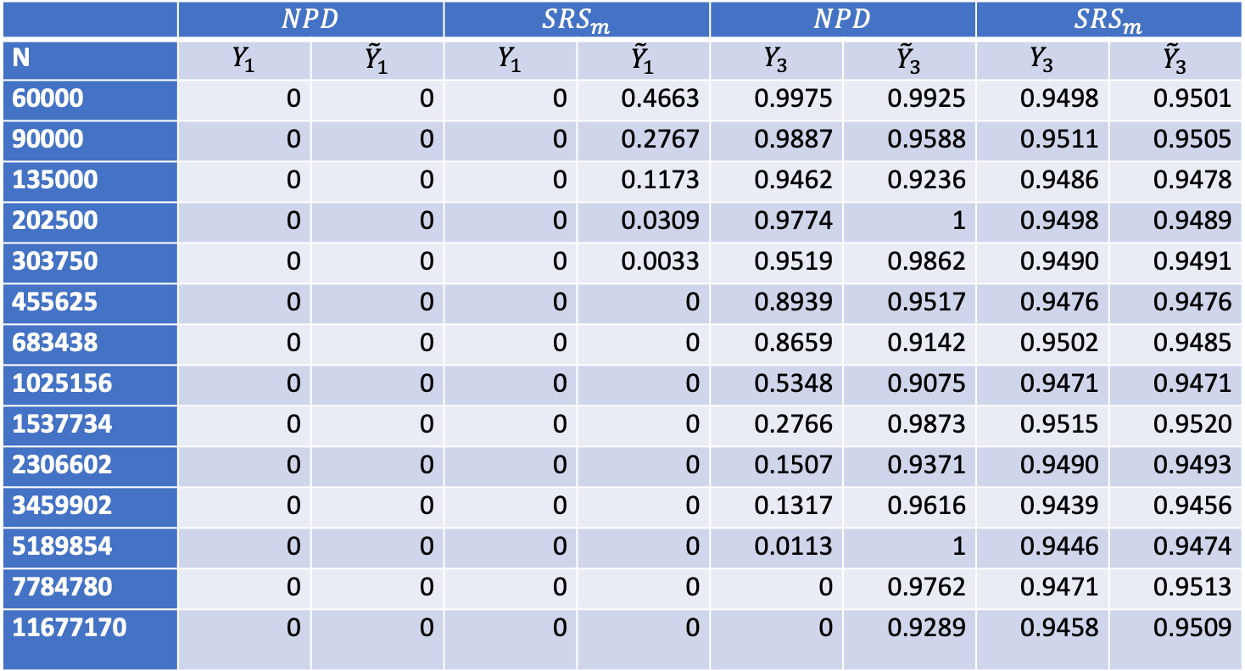
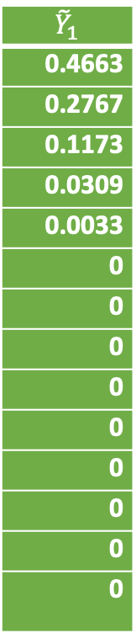
Coverage probability
 | $$NPD$$ |  | $$SRS_{m}$$ |  | $$NPD$$ |  | $$SRS_{m}$$
N | $$Y_{1}$$ | $${\tilde{Y}}_{1}$$ | $$Y_{1}$$ | $${\tilde{Y}}_{1}$$ | $$Y_{3}$$ | $${\tilde{Y}}_{3}$$ | $$Y_{3}$$ | $${\tilde{Y}}_{3}$$
60000 | 0 | 0 | 0 | 0.4663 | 0.9975 | 0.9925 | 0.9498 | 0.9501
90000 | 0 | 0 | 0 | 0.2767 | 0.9887 | 0.9588 | 0.9511 | 0.9505
135000 | 0 | 0 | 0 | 0.1173 | 0.9462 | 0.9236 | 0.9486 | 0.9478
202500 | 0 | 0 | 0 | 0.0309 | 0.9774 | 1 | 0.9498 | 0.9489
303750 | 0 | 0 | 0 | 0.0033 | 0.9519 | 0.9862 | 0.9490 | 0.9491
455625 | 0 | 0 | 0 | 0 | 0.8939 | 0.9517 | 0.9476 | 0.9476
683438 | 0 | 0 | 0 | 0 | 0.8659 | 0.9142 | 0.9502 | 0.9485
1025156 | 0 | 0 | 0 | 0 | 0.5348 | 0.9075 | 0.9471 | 0.9471
1537734 | 0 | 0 | 0 | 0 | 0.2766 | 0.9873 | 0.9515 | 0.9520
2306602 | 0 | 0 | 0 | 0 | 0.1507 | 0.9371 | 0.9490 | 0.9493
3459902 | 0 | 0 | 0 | 0 | 0.1317 | 0.9616 | 0.9439 | 0.9456
5189854 | 0 | 0 | 0 | 0 | 0.0113 | 1 | 0.9446 | 0.9474
7784780 | 0 | 0 | 0 | 0 | 0 | 0.9762 | 0.9471 | 0.9513
11677170 | 0 | 0 | 0 | 0 | 0 | 0.9289 | 0.9458 | 0.9509
$${\tilde{Y}}_{1}$$
0.4663
0.2767
0.1173
0.0309
0.0033
0
0
0
0
0
0
0
0
0
$$Y_{3}$$
0.9975
0.9887
0.9462
0.9774
0.9519
0.8939
0.8659
0.5348
0.2766
0.1507
0.1317
0.0113
0
0

Slide 16
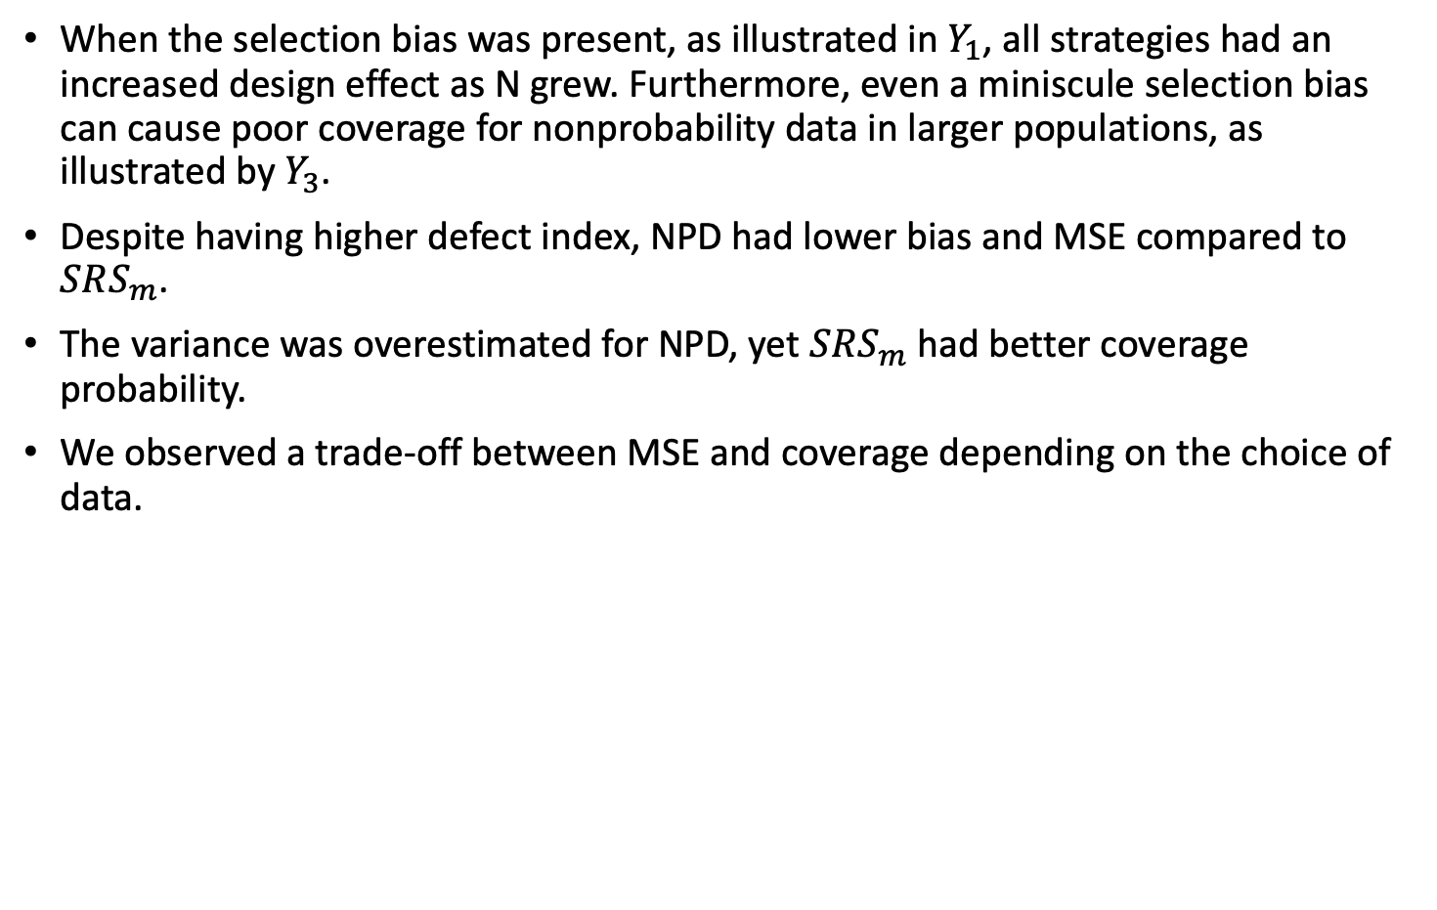
Conclusions and reflections
When the selection bias was present, as illustrated in $Y_{1}$, all strategies had an increased design effect as N grew. Furthermore, even a miniscule selection bias can cause poor coverage for nonprobability data in larger populations, as illustrated by $Y_{3}$.
Despite having higher defect index, NPD had lower bias and MSE compared to $SRS_{m}$.
The variance was overestimated for NPD, yet $SRS_{m}$ had better coverage probability.
We observed a trade-off between MSE and coverage depending on the choice of data.

Slide 17
Thank you for your time!
Hyllienmark M., Hedlin D. & Bueno E. Selection bias in big data: A practitioner’s point of view. Manuscript

